Slide 1

HEART DISEASE DETECTION USING MACHINE LEARNING
BATCH MEMBERS:
Arunkumar R [513319104006]
Nithish Kumar B [513319104022]
Panneerselvam K [513319104025]
Surya A [513319104041]
GUIDE:
Mrs.G.Julin Leeya, M.Tech.,
CSE Department
UCEA

Slide 2
ABSTRACT
For Heart Disease prediction we use new dataset which weren’t used in recent years.
Replacing with new Machine Learning algorithms which gives better result and also for futuristic work.
We use undersampling and oversampling to overcome data imbalancing.
And we use cluster type architecture to group the people with similar health condition.

Slide 3
INTRODUCTION
It is commonly believed that heart disease, which is brought on by abnormalities in the heart and blood vessels, directly endangers human life and health.
It is one of the serious illnesses that affects many older and middle-aged persons in an irreversible manner and that frequently leads to deadly consequences.
Scientists asserts that cardiovascular heart disease increases the risk of death and disability in those 65 and older.

Slide 4
LITERATURE SURVEY
AUTHOR | TITLE | YEAR | OVERVIEW
R Sivaprasad, M. Hema, Bharati N Ganar, D M Sunil, Vaishali Mehta, Mochammad Fahlevi | Heart Disease Prediction and Classification using Machine Learning and Transfer Learning Model | 2022 | The proposed RFMS(Remote Fiber Monitoring Device)- MLPNN(Multilayer perceptron neural network ) produce higher performance by evaluating the cardiac features than other methods. This recommends the risk level based on classes by predicting the feature class and recommend risk-based disease diagnosis. And they have used IOT sensors.
Sameer Pandey, Ravinder Kaur | Heart Failure Prediction Using Machine Learning Algorithm | 2021 | They have achived some more accuracy with KNN algorithm of having some false negative values, then they used vector classifier model and gained the massive accuracy rate of 94.56%

Slide 5
LITERATURE SURVEY
AUTHOR | TITLE | YEAR | OVERVIEW
Ch Raja Shaker, Anisetti Sidhartha, Anto Praveena, A. Chrsity, B. Bharati | An Analysis of Heart Disease Prediction using Machine Learning and Deep Learning Techniques | 2022 | They have used both machine learning and deep learning algorithms of that ML algorithms were outperformed. Of that Random Forest Classifiers, Decision Tree Classifiers, and Nave Bayes algorithms super-performed other ML algorithms, according to the findings.
Senthilkumar Mohan; Chandrasegar Thirumalai; Gautam Srivastava | Effective Heart Disease Prediction Using Hybrid Machine Learning Techniques | 2019 | They proposed hybrid HRFLM(Hybrid Random Forest With A Linear Model ) approach is used combining the characteristics of Random Forest (RF) and Linear Method (LM). HRFLM proved to be quite accurate in the prediction of heart disease.

Slide 6
EXISTING SYSTEM
We came to know that machine learning algorithms with self-measurable indicators do not predict more accurately as ML algorithms with all physical condition indicators .
Self-measurable indicators are also more likely to falsely predict for people who don’t have that heart disease.
Thus, ML algorithms with only self-measurable indicators shouldn’t be used until someother indicators are measurable at home in future.

Slide 7
PROPOSED SYSTEM
We include other health attributes from the orginal dataset.
We Found the machine learning algorithm that has the best accuracy and the fewest false negatives.
Since each patient has a unique set of medical conditions, so we group the patients those who have similar conditions like clusters.
So, we use machine learning algorithms like stochastic gradient descent and Naïve bayes for replacement.

Slide 8
MODULES SPLIT-UP
DATA CLEANING(PRE-PROCESSING)
EXPLORATORY DATA ANALYSIS(EDA)
NORMALISATION
MODELLING USING ML ALGORITHMS
TESTING & TRAINING
COMPARSION

Slide 9
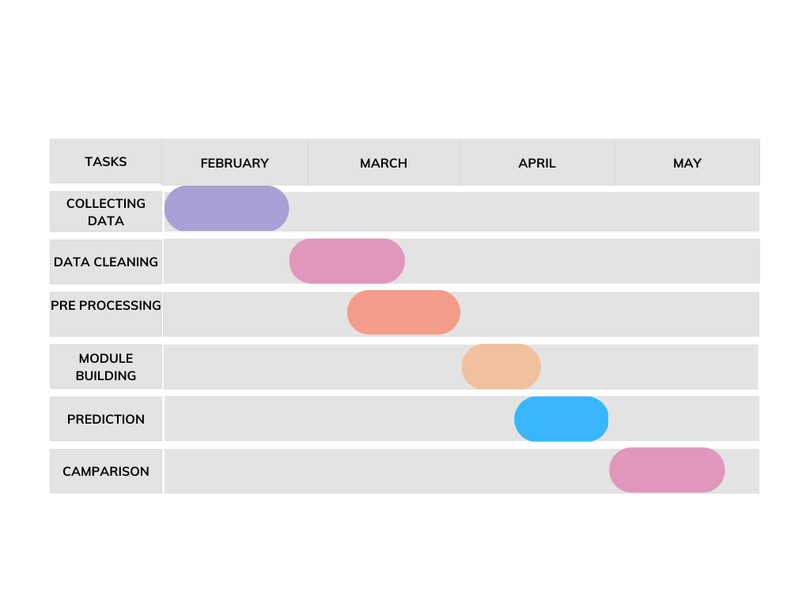
GANTT CHART

Slide 10
REFERENCES
Avinash Golande, Pavan Kumar T, Heart Disease Prediction Using Effective Machine Learning Techniques, International Journal of Recent Technology and Engineering, Vol 8, pp.944-950,2019.
T.Nagamani, S.Logeswari, B.Gomathy, Heart Disease Prediction using Data Mining with Mapreduce Algorithm, International Journal of Innovative Technology and Exploring Engineering (IJITEE) ISSN: 2278-3075, Volume-8 Issue-3, January 2019.
Fahd Saleh Alotaibi, Implementation of Machine Learning Model to Predict Heart Failure Disease, (IJACSA) International Journal of Advanced Computer Science and Applications, Vol. 10, No. 6, 2019.
Anjan Nikhil Repaka, Sai Deepak Ravikanti, Ramya G Franklin, Design And Implementation Heart Disease Prediction Using Naives Bayesian, International Conference on Trends in Electronics and Information(ICOEI 2019).
Theresa Princy R,J. Thomas,Human heart Disease Prediction System using Data Mining Techniques, International Conference on Circuit Power and Computing Technologies,Bangalore,2016.
Nagaraj M Lutimath,Chethan C,Basavaraj S Pol.,Prediction Of Heart Disease using Machine Learning, International journal Of Recent Technology and Engineering,8,(2S10), pp 474-477, 2019.
UCI, Heart Disease Data Set.[Online]. Available (Accessed on May 1 2020): https://www.kaggle.com/ronitf/heart-disease-uci.
Sayali Ambekar, Rashmi Phalnikar,Disease Risk Prediction by Using Convolutional Neural Network,2018 Fourth International Conference on Computing Communication Control and Automation.
C. B. Rjeily, G. Badr, E. Hassani, A. H., and E. Andres, Medical Data Mining for Heart Diseases and the Future of Sequential Mining in Medical Field, in Machine Learning Paradigms, 2019, pp. 7199.
Jafar Alzubi, Anand Nayyar, Akshi Kumar. "Machine Learning from Theory to Algorithms: An Overview", Journal of Physics: Conference Series, 2018

Slide 11
THANK YOU !

